Slide 1


Slide 2
Introduction to Git Actions
Git Actions is a feature of GitHub that allows you to automate various tasks in your software development workflow.
Importance: It's a powerful tool for enhancing efficiency, improving code quality, and reducing manual work.
Automation involves using tools and scripts to perform repetitive tasks automatically.
Benefits: Automation saves time, reduces errors, and ensures consistency.
+ build
+ test
+ package
+ release
+ deploy

Slide 3
Git Actions Basics
Git Actions are workflows defined in YAML files that automatically execute tasks. The YAML file contains a recipe.
The recipe will run when triggered by an event in the repository / manually / defined schedule.
Use Cases: They can be used for continuous integration (CI), continuous deployment (CD), testing, and more

Slide 4
Triggers and Events
Triggers: Git Actions are triggered by events like pushes, pull requests, or issue comments.
https://docs.github.com/en/actions/using-workflows/events-that-trigger-workflows

Slide 5
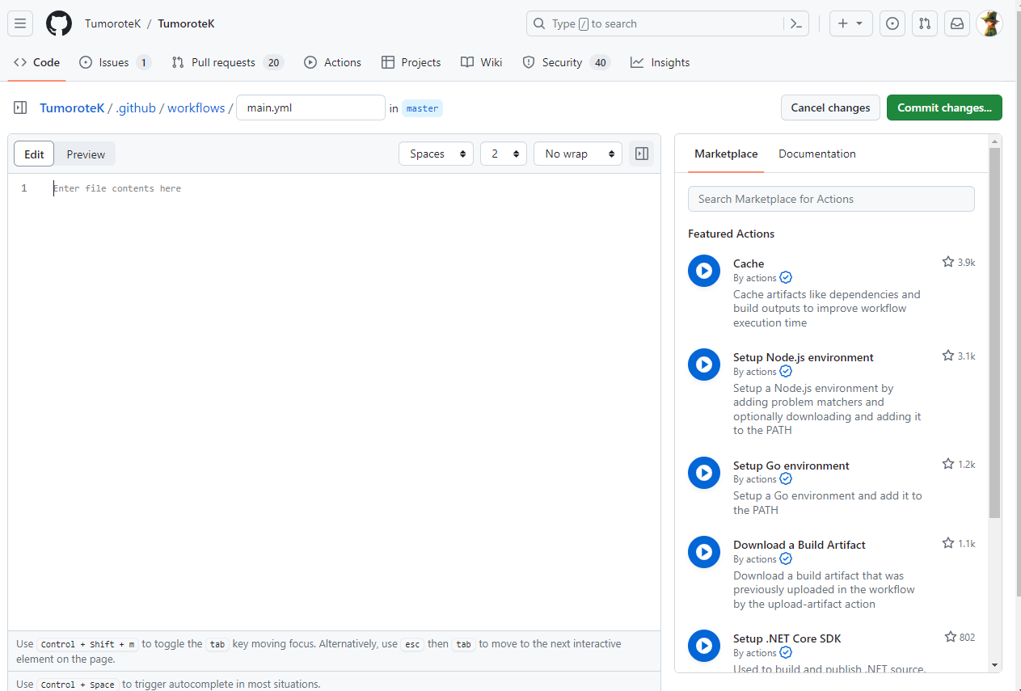
Getting Started with Git Actions
Manually
Via GitHub
1. Create a .github/workflows folder in root
2. create a yaml file
3. Configure it
4. Push to remote
Every change to the yaml file, even the slighest, requires a push to remote

Slide 6
Workflow Syntax
Workflow files use YAML syntax, which is human-readable and easy to understand.
Keywords like name, on, jobs, and steps are used to structure workflows.
[open the example.yaml]

Slide 7
Workflow Components
A workflow consists of one or more jobs. Each job is composed of one or more steps. Steps are individual units of work that are executed sequentially. A workflow runs on a runner, each job receive a new instance of a runner.
**Job:** set of steps (tasks) that are executed on a specific environment (runner). Jobs run in parallel by default, which can help speed up the workflow's execution time. You can also configure jobs to run sequentially if needed. But what if deploy need build? You can’t run them paraell…
**Step:** a shell command, a script, or a [pre-defined action](https://github.com/marketplace?type=actions). For instance, a "Build" job might have steps to install dependencies, compile code, and generate artifacts. Each one is a step.
**Runner:** virtual machine that execute the jobs in your workflow. Runners are responsible for setting up the environment, executing steps, and reporting the results back to GitHub. You can customize runners to meet your specific requirements.

Slide 8
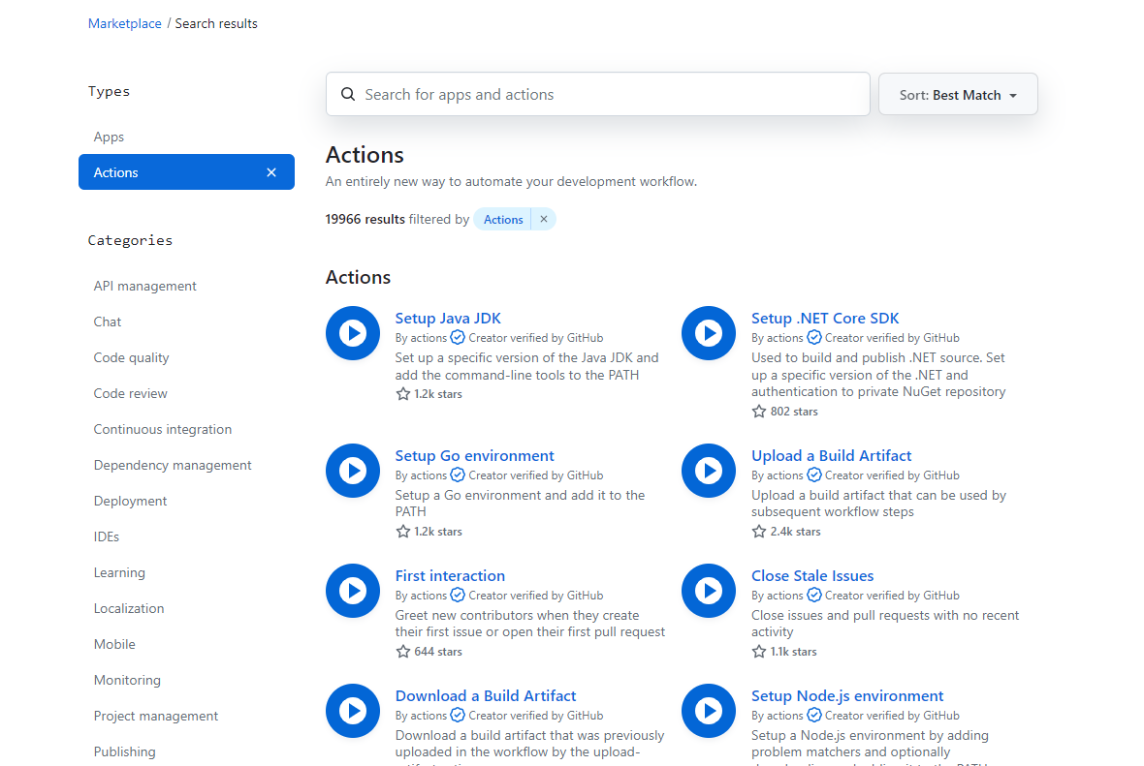
GitHub Marketplace:
GitHub provides a wide range of pre-defined actions that you can include in your workflows, and you can also create custom actions to suit your specific needs.

Slide 9
Running the Workflow
Once you've defined your workflow and committed the YAML file to your repository, GitHub Actions will automatically start running the workflow whenever the specified triggering event occurs. You can monitor the progress of your workflow from the "Actions" tab in your repository.
As the workflow runs, you'll see live logs that provide details about each step's execution. These logs include the output of commands, any errors encountered, and the overall status of the workflow. If any step fails, GitHub will highlight the issue, allowing you to quickly identify and address the problem.

